Slide 1
Week 7: Regularization
Dr Supriya

Slide 2
Regularization
Any modification we make to a learning algorithm that is intended to reduce its generalization error but not its training error.
The goal of Regularization is to prevent overfitting by imposing some strategies such as :
Put extra constraints on a machine learning model
Add extra terms in the objective function
Impose ensemble method
Notes:
Regularisation is a technique used in machine learning and neural networks to prevent overfitting and improve a model’s ability to generalise to new data. It works by adding a penalty to the model’s learning process, discouraging overly complex models that fit the training data too closely, including noise. This is typically achieved by modifying the loss function to include a regularisation term, which constrains the size of the model’s weights. Common approaches include L1 regularisation, which can reduce some weights to zero and aid feature selection, L2 regularisation, which keeps weights small and stable, and dropout, which randomly deactivates neurons during training to prevent reliance on specific features. By controlling model complexity, regularisation helps strike a balance between underfitting and overfitting, leading to more robust and reliable predictions.

Slide 3
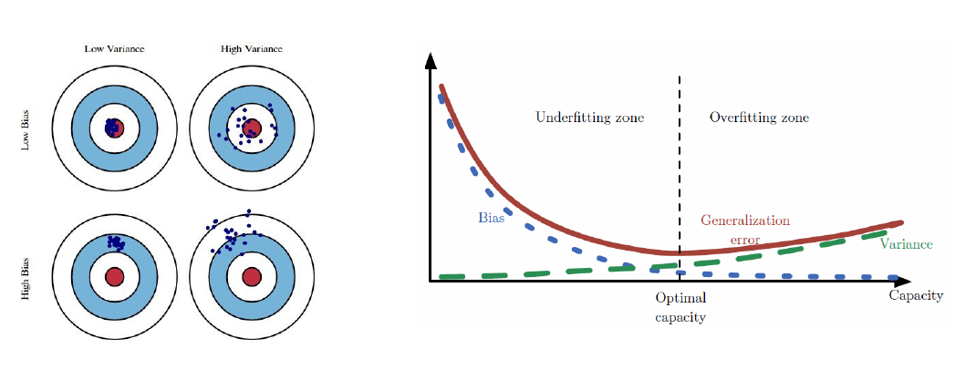
Bias variance trade off
Regularization of an estimator works by trading increased bias for reduced variance
https://www.kdnuggets.com/2016/08/bias-variance-tradeoff-overview.html

Slide 4
Bias-Variance Trade-off
Recall the old saying Garbage in, garbage out
which refers to the quality of data an algorithm or system processes to provide a (hopefully) enhanced or useful output
if the data it is processing is plagued with errors, then it is likely the results will be skewed or plain wrong
The same is true in machine learning algorithms
Data often referred to as “training data” needs to be analyzed for two important qualities within the dataset:
Bias
Bias refers to assumptions in training data that need to be addressed for better prediction, it is an inherent error in data
Variance
variance is related to model perfection and occurs when a model tries to fit several inputs
So, how do these qualities of the training dataset affect the results of the machine learning algorithms? .......relationship between them is called the Bias-Variance Tradeoff

Slide 5
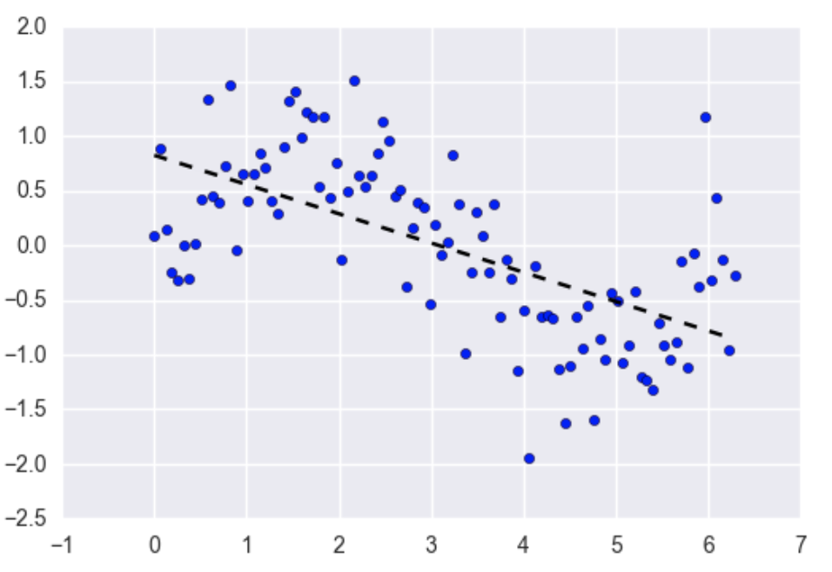
Bias-Variance Trade-off
The Bias-Variance Tradeoff is relevant for supervised machine learning - specifically for predictive modeling
It's a way to diagnose the performance of an algorithm by breaking down its prediction error
Bias is the difference between your model's expected predictions and the true values
Imagine fitting a linear regression to a dataset that has a non-linear pattern:
No matter how many more observations you collect, a linear regression won't be able to model the curves in that data
This is known as under-fitting

Slide 6
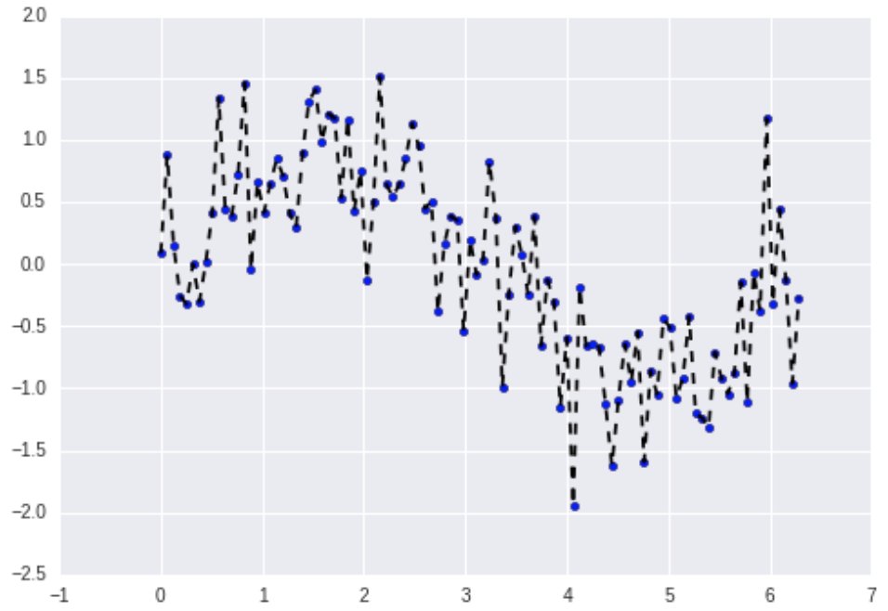
Bias-Variance Trade-off
Variance refers to your algorithm's sensitivity to specific sets of training data
High variance algorithms will produce drastically different models depending on the training set
For example, imagine an algorithm that fits a completely unconstrained, super-flexible model to the same dataset from the linear regression example:
As you can see, this unconstrained model has basically memorized the training set, including all of the noise
This is known as over-fitting.

Slide 7
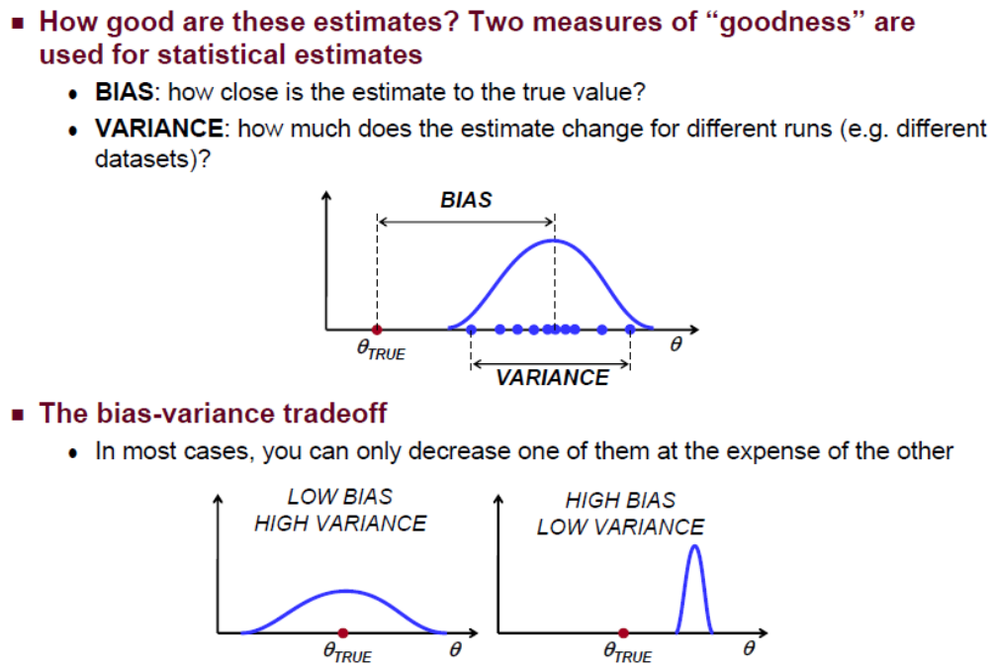
Bias-Variance Tradeoff

Slide 8
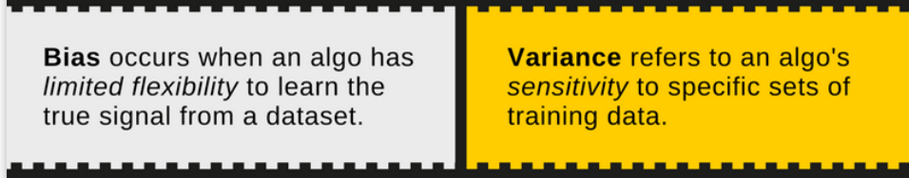
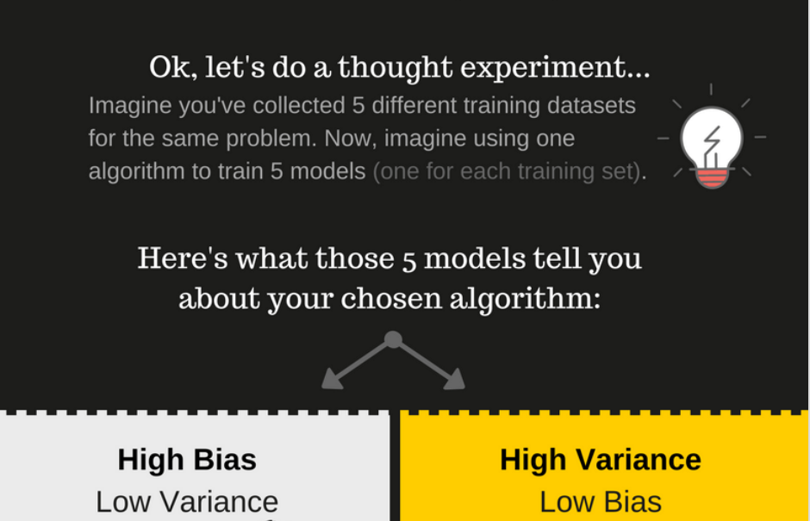

Slide 9
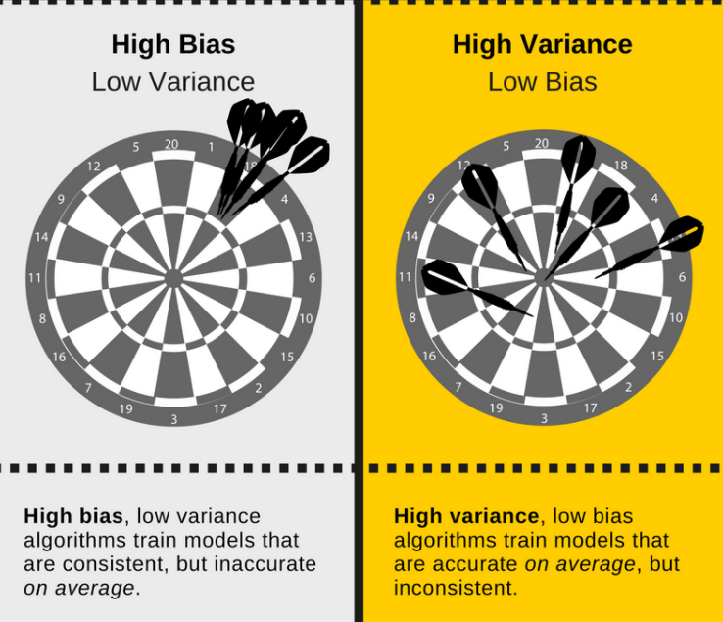

Slide 10
Weights for features
Learned automatically by the model during training.
Driven-an optimization algorithm (gradient descent)
Aim to minimize a specific function called the loss function.
Here’s how it works:
Initialize Weights Randomly
Calculate Loss
Adjust Weights (Gradient Descent)
Iterate Until Convergence.

Slide 11

Why Some Features Have Larger Weights than Others
In a model predicting house prices:
Square footage : large positive weight
Proximity to city center: significant weight
Unrelated features, like a house's paint color : A weight close to zero,

Slide 12
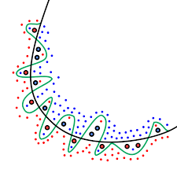
Goal: Reduce Overfitting
After training, most models perform well on a specific subset of the data but struggle to generalize to new, unseen examples
a problem known as overfitting.
To address this, we aim to reduce the model's complexity and/or decrease the variability in its predictions.

Slide 13
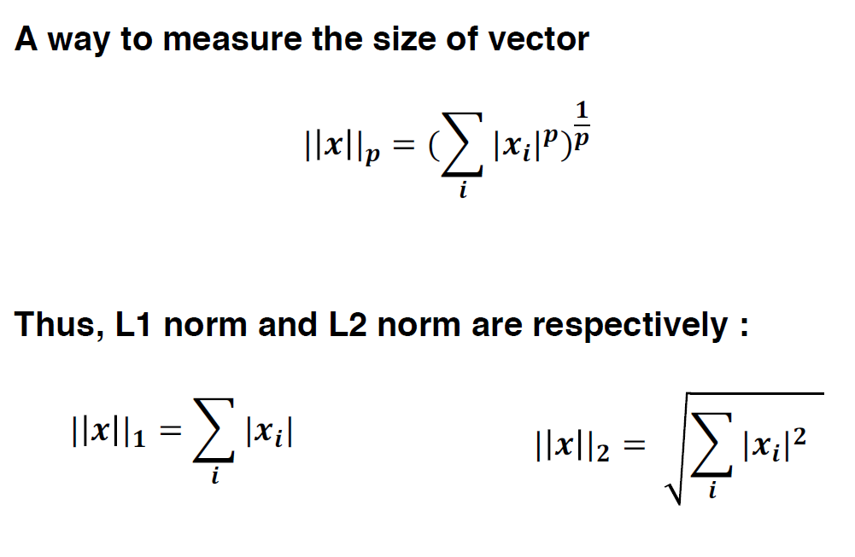
Norm
A norm is a mathematical way to measure the "size" or "magnitude" of a model's parameters (such as weights).

Slide 14
Regularization
Regularization is a technique that adds a small "extra cost" or penalty to the usual process of training a machine learning model.
Model with high weight--------lead to overfitting.
Why is the Penalty Related to Weights?
Keep the weights small and balanced.
Simplify the model’s learning

Slide 15
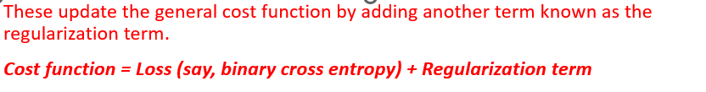
How the Penalty Works in the Loss Function
A loss function measures how far off the model's predictions are from the actual values. For example:
Without regularization
With regularization

Slide 16
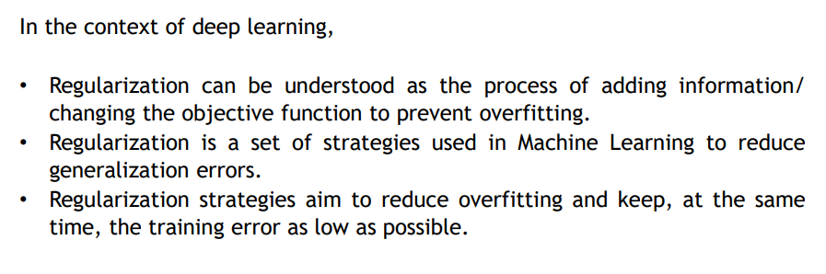
Regularization / Regularizing Effects

Slide 17
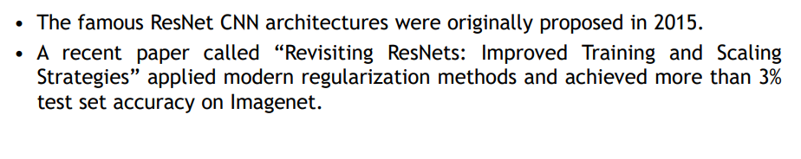
Why regularization?

Slide 18
Norm
A norm is a mathematical way to measure the "size" or "magnitude" of a model's parameters (such as weights).

Slide 19
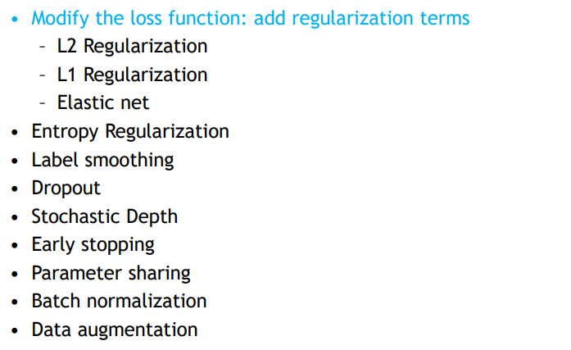
Different Regularization Techniques in Deep Learning

Slide 20
Different Regularization Techniques in Deep Learning (practice in class)
L2&L1 regularization
Dropout
Data Augmentation
Early stopping

Slide 21

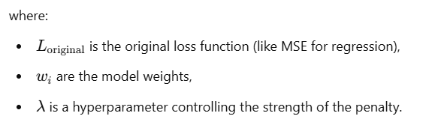
L1 Regularization (Lasso Regularization):
L1 Regularization adds a penalty proportional to the absolute values of the weights.
This penalty encourages sparsity, setting some weights exactly to zero, which can lead to feature selection within the model.

Slide 22


L2 Regularization (Ridge Regularization):
L2 Regularization adds a penalty term proportional to the square of the magnitude of the weights.
This penalty encourages the model to keep weights small and smoothens the learned function.

Slide 23
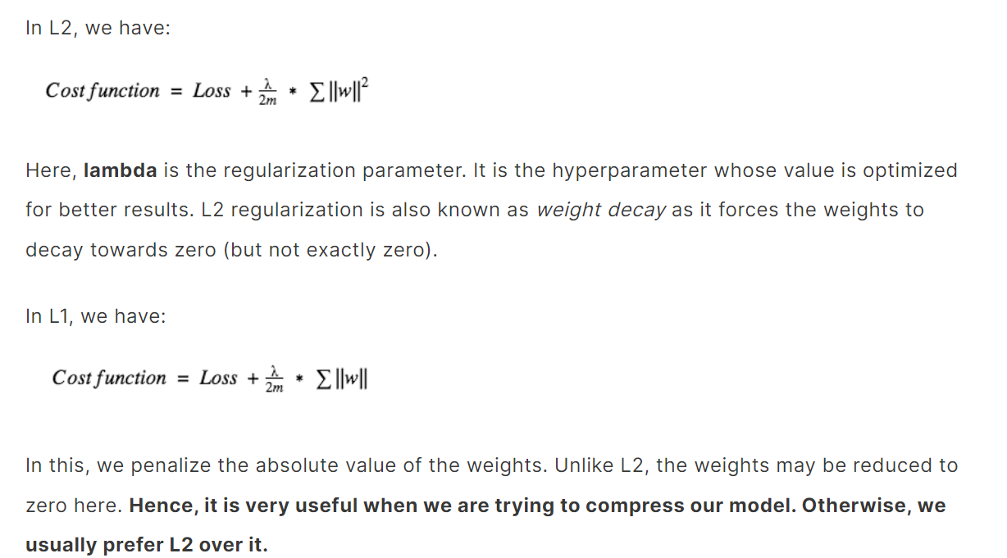
L2&L1 regularization

Slide 24
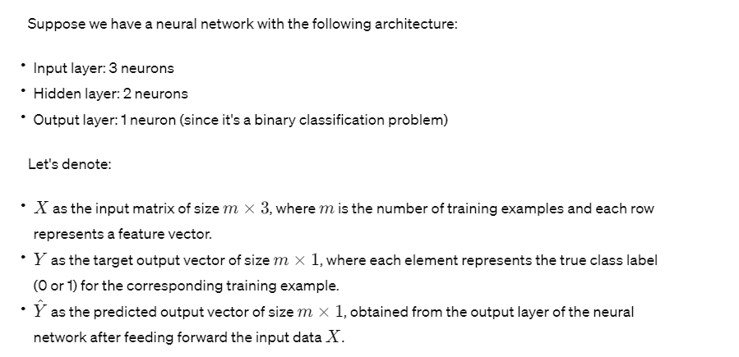
The cross-entropy loss function for binary classification

Slide 25
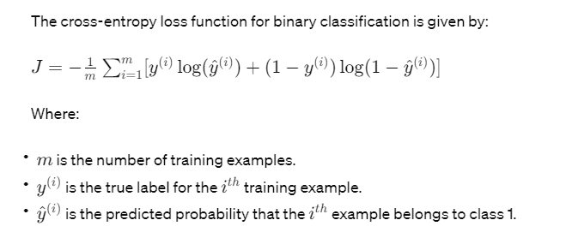
The cross-entropy loss function for binary classification
The cross-entropy loss function for binary classification is given by:

Slide 26
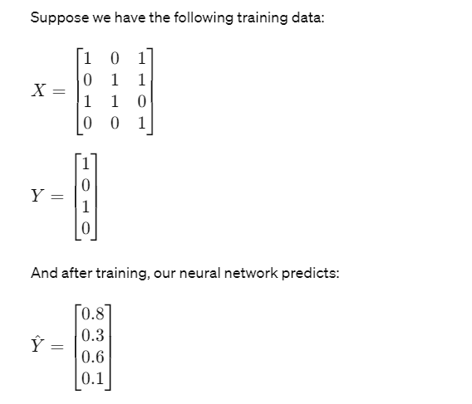

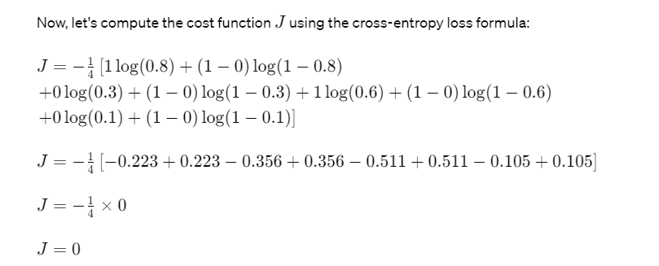
So, in this example, the cost function (cross-entropy loss) is 0, indicating that the predicted probabilities match the true labels perfectly. In practice, the goal of training the neural network would be to minimize this cost function through techniques like gradient descent.

Slide 27
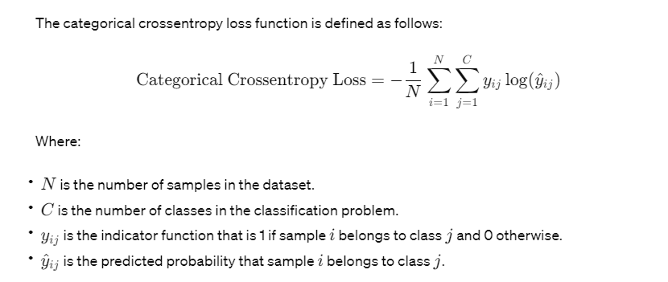
Categorical crossentropy loss function
With multi-class classification problems like the Iris dataset the categorical crossentropy loss function is used

Slide 28
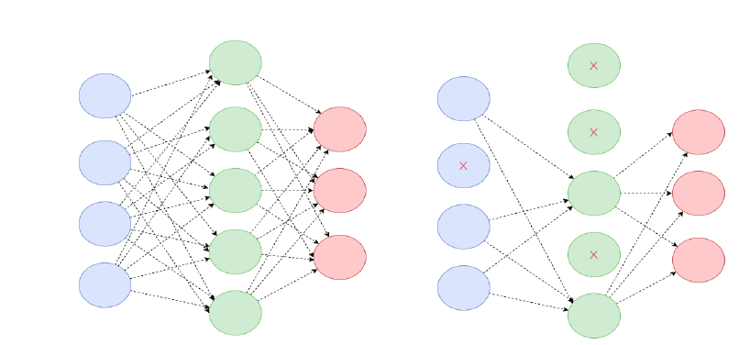
Dropout
This probability of choosing how many nodes should be dropped is the hyperparameter of the dropout function.

Slide 29
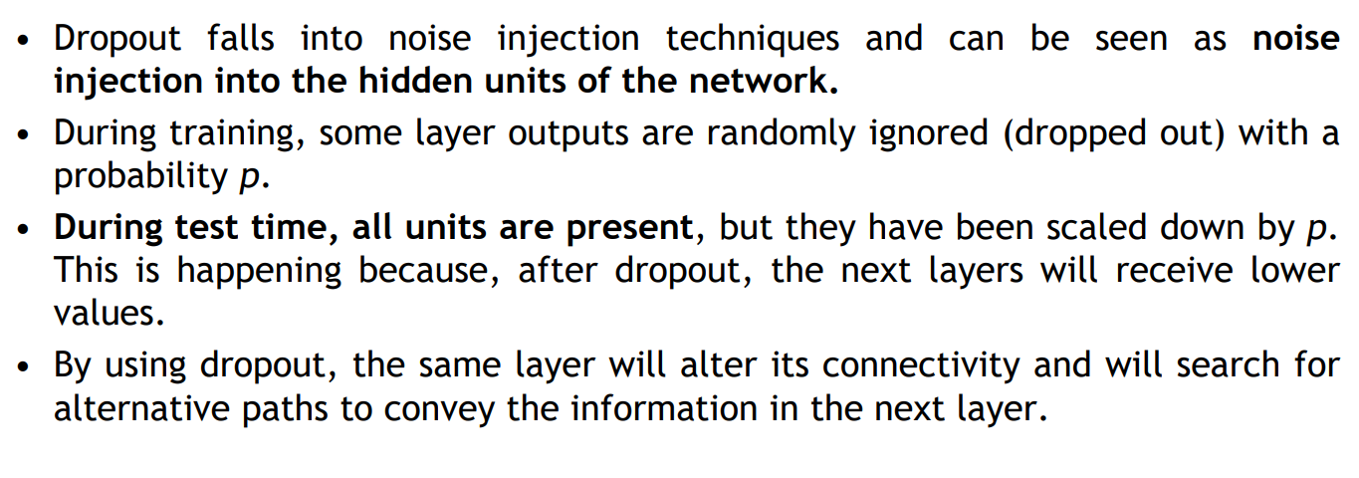
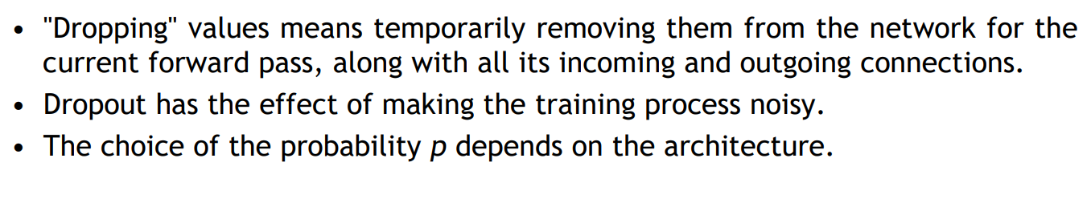
Dropout

Slide 30
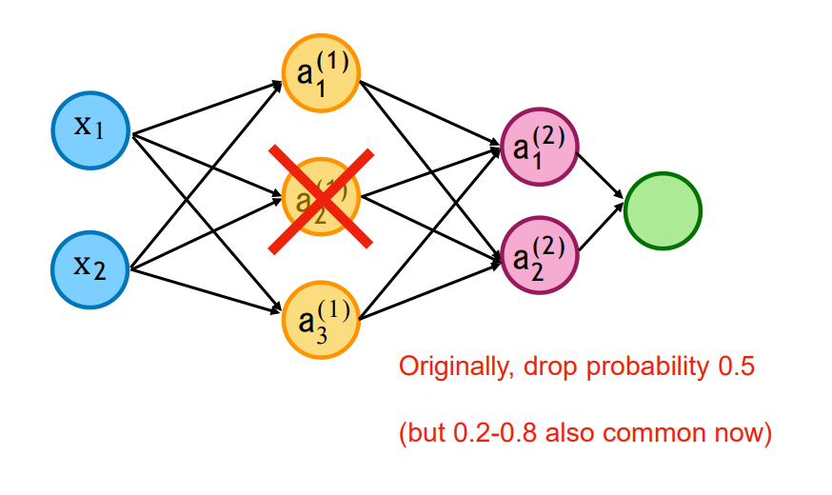
Dropout in a Nutshell: Dropping Nodes

Slide 31
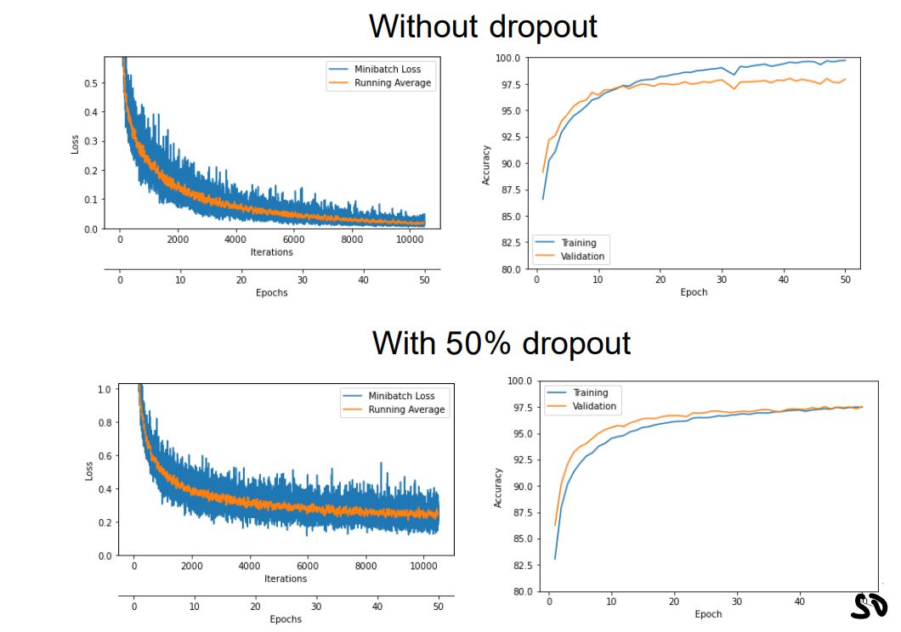

Slide 32
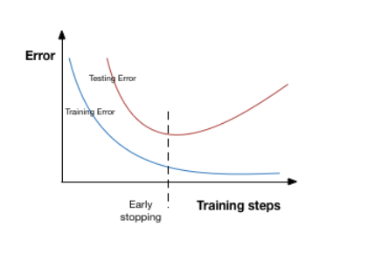
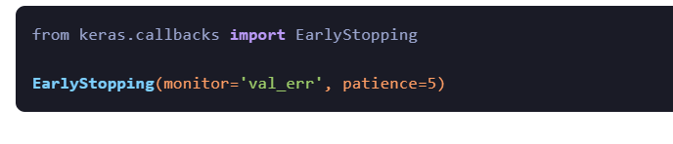
Early stopping
Learning too much iterations causes overfitting

Slide 33
Thank you

